Slide 1
Agile

Slide 2
Introduction
Software
Collection of data or computer instructions that tell the computer how to work
Software Engineering
Study of methodologies applied in the design, development & maintenance of software
Software Development Life Cycle
Series of steps to be followed to design & develop a software product efficiently

Slide 3
Steps in SDLC(Typical)
Communication
Requirements Gathering
Feasibility Study
System Analysis
Software Design
Coding
Testing
Integration
Implementation or Installation
Operation & Maintenance
Disposition

Slide 4
WaterFall Model
Introduced by Winston Royce
Linear Sequential Life Cycle Model
Simple & easy to understand
Every phase must be completed before going to the next step
Product is short
Requirement is clear & fixed
Time to Market is low

Slide 5
WaterFall Model
Requirement Analysis
System Design
Implementation
Testing
Deployment
Maintenance

Slide 6
V Model
Introduced by Paul E Brook – 1986
Designed to be non linear
Modified version of waterfall model
Also called as Verification and Validation model
Development of each step is directly associated with the testing phase.

Slide 7
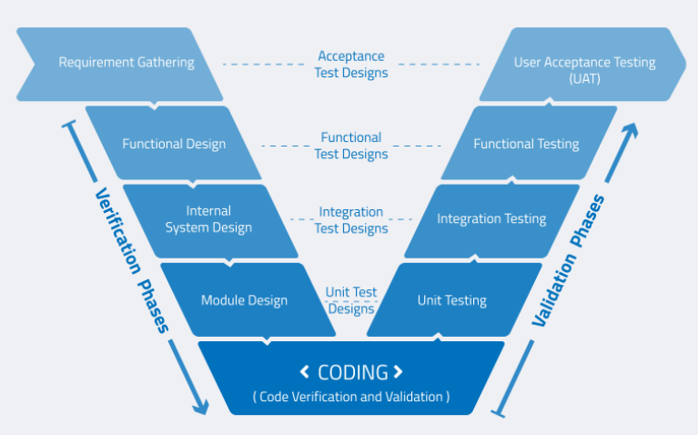
V Model

Slide 8
Agile
Agile -
Able to move quickly & easily
Agile Evolution -
Software evolves over time. With this came the need of changing requirements, cross functional teams. It was necessary to accommodate –
Adaptive planning
Evolutionary development
Early delivery
There was also a need to deliver value to the customer, to the business sooner
Flexible to change

Slide 9
Agile History and Core Values
In early 90’s software industry faced a lot of problems from the early SDLC models
In 2001 - Agile Software Development
Came up with the Agile Manifesto
17 people named themselves as the “Agile Alliance”
AGILE MODEL is a combination of INCREMENTAL and ITERATIVE MODEL
It revolves round certain core values and principles

Slide 10
Agile
4 core values of Agile Manifesto
Individuals & Interactions overs processes & tools
Working software over comprehensive documentation
Customer collaboration over contract negotiation
Respond to change over following a plan
Enhanced Reading - https://agilemanifesto.org/principles.html
The heart principle of the AGILE MODEL is the “Customer Satisfaction by early and continuous delivery of valuable Software”

Slide 11
Key Features of Agile
Everyone is a part of the team
Operating mechanics are highly interdependent
Two main units of delivery: releases and iterations
Product or domain expert
Cross functional teams
Leadership roles (SM, TL, PO)
Agile coach/mentor

Slide 12
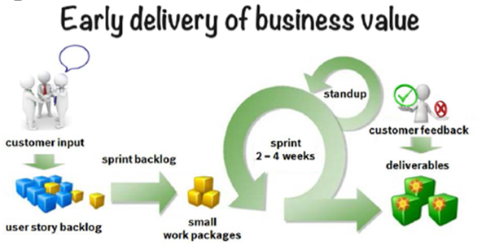
How to work agile?
Describe tasks from customer perspective.
Limit work-in-progress to avoid multi-tasking!
Prioritize tasks strictly based on business value
Transfer the prioritized tasks to fit into a sprint of 2-4 weeks
During the sprint, the team works self-organized, and responsible in agreed amount of work and commits to deliver
After the sprint, the deliverables are demonstrated to and judged by the customers.
Lessons learned and peer feedback is an essential part of each sprint and serves as an input for next one(learning in process).

Slide 13
Agile Methodologies
Scrum
Extreme Programming (XP)
Crystal
Dynamic Systems Development Method (DSDM)
Feature Driven Design (FDD)
Lean Software Development
Kanban

Slide 14
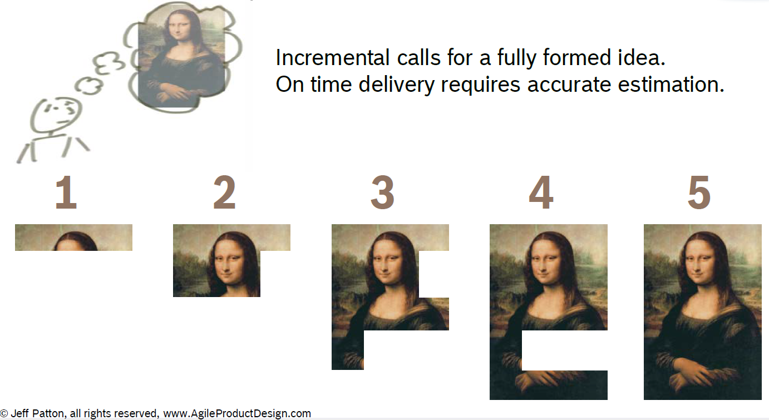
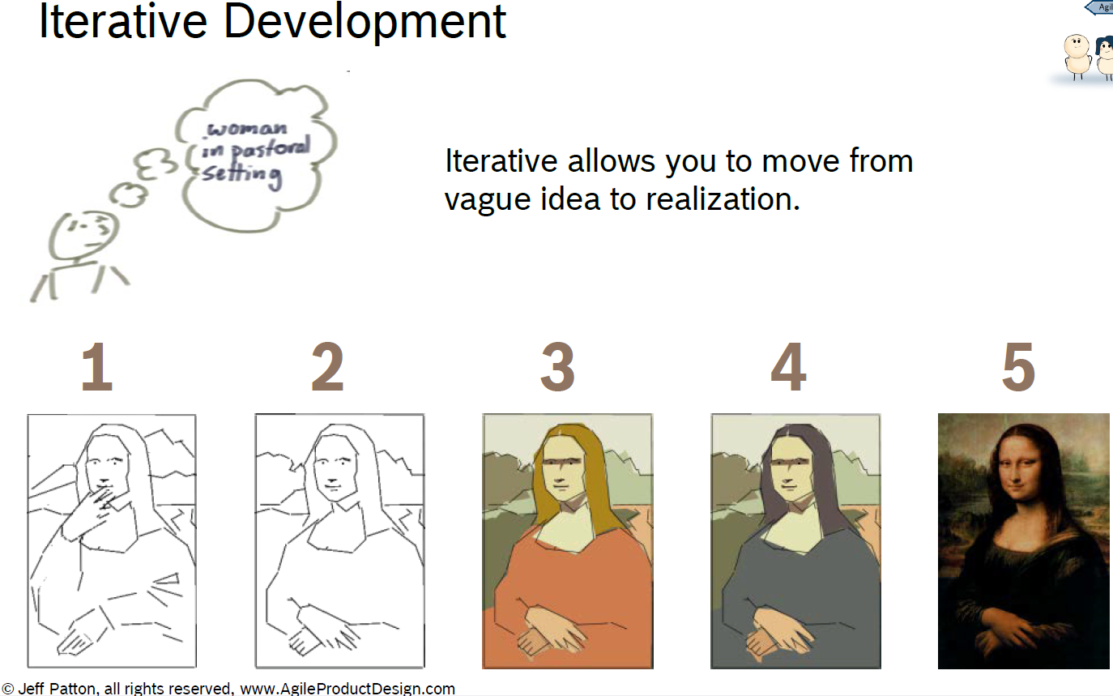
Scrum Overview
Agile = Incremental + Iterative

Slide 15
Characteristics of Scrum
Agile Management framework - Lightweight and iterative
3 main areas – Artifacts, Roles, Ceremonies
Team-based approach
Self-organizing teams
Time-boxed
Controls interests and needs
Improves communication
Maximizes cooperation

Slide 16
Scrum Framework
3 Artifacts:
Product Backlog
Sprint Backlog
Burn-down Chart
4 Roles:
Stakeholders
Product Owner
Scrum Master
Development Team
5 Meetings/Ceremonies:
Change control board
Sprint Planning
Daily Scrum
Sprint Review
Sprint Retrospective

Slide 17
Scrum Framework
3 Artifacts:
Product Backlog
Sprint Backlog
Burn-down Chart
4 Roles:
Stakeholders
Product Owner
Scrum Master
Development Team
5 Meetings/Ceremonies:
Change control board
Sprint Planning
Daily Scrum
Sprint Review
Sprint Retrospective

Slide 18
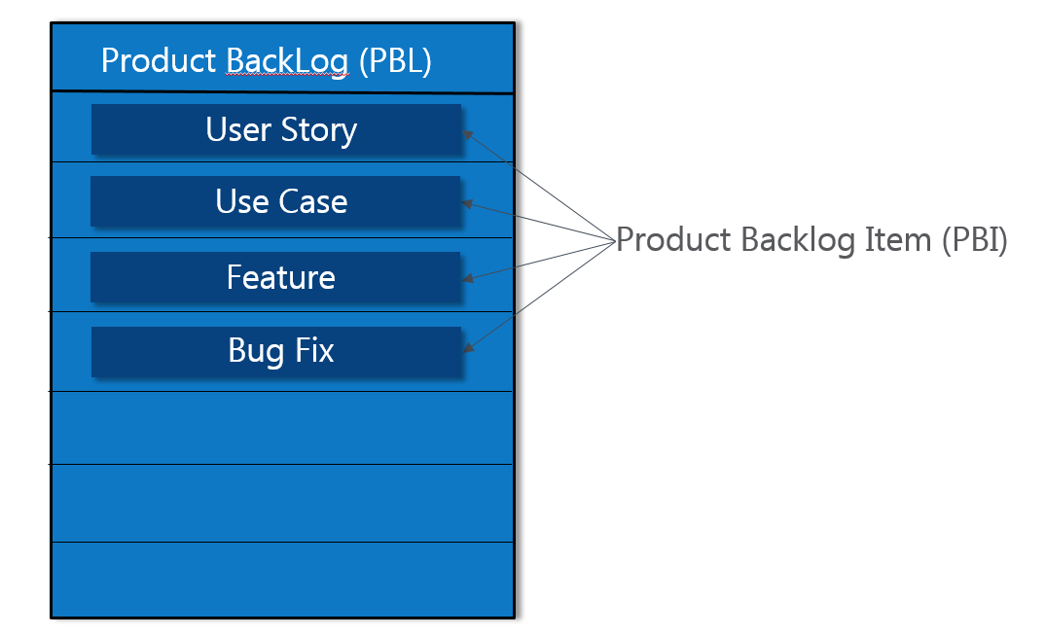
Product Backlog(PBL)

Slide 19
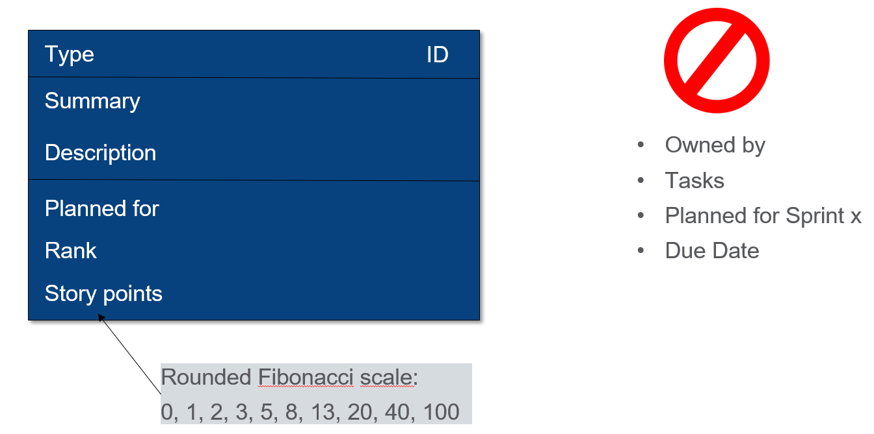
Product Backlog Item (PBI)

Slide 20
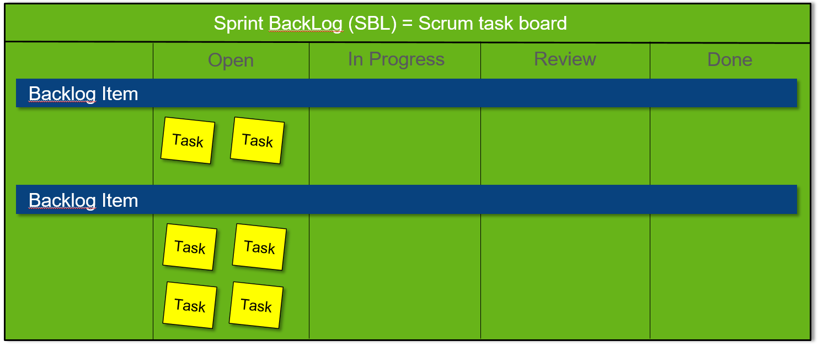
Sprint Backlog (SBL)

Slide 21
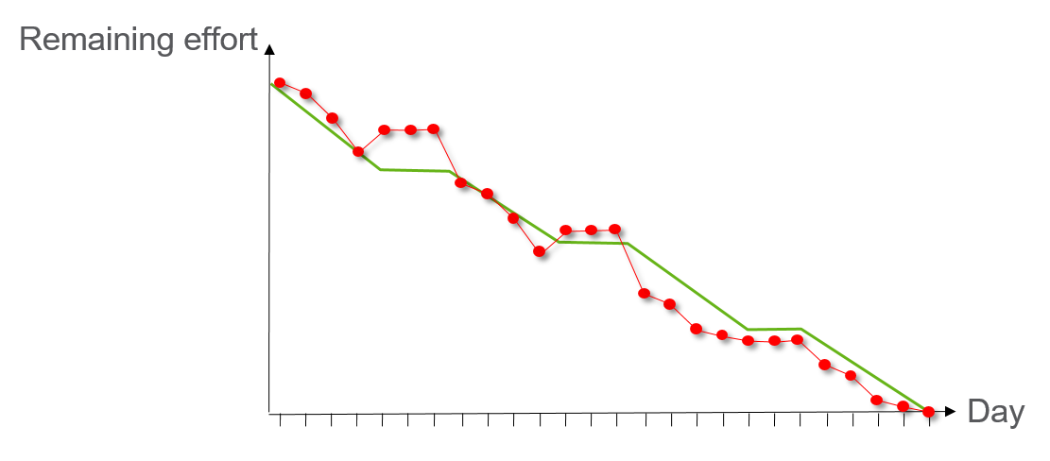
Burn-down chart
Task(Effort) v/s Plan(Time/Duration)
Published at end of every sprint by SM
Release burn down plan
Whether timeline is over estimated or under estimated

Slide 22
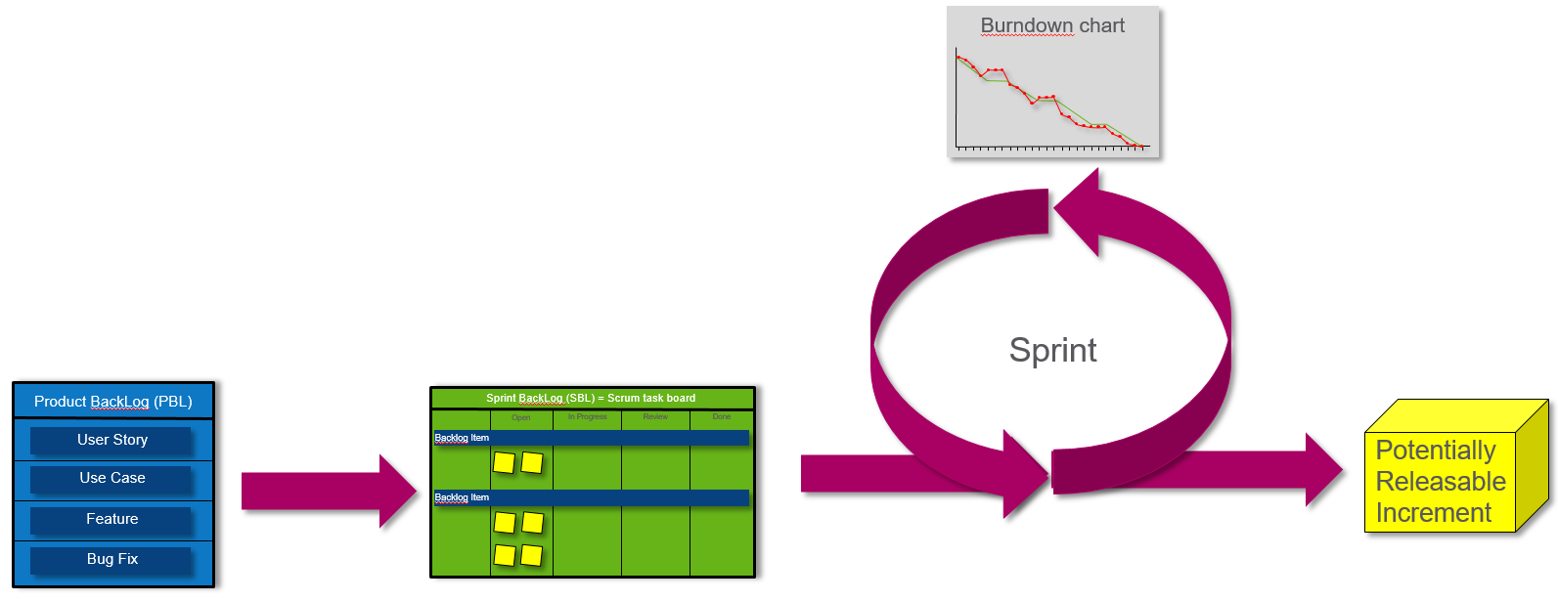
Putting it together…..

Slide 23
Scrum Framework
3 Artifacts:
Product Backlog
Sprint Backlog
Burn-down Chart
4 Roles:
Stakeholders
Product Owner
Scrum Master
Development Team
5 Meetings/Ceremonies:
Change control board
Sprint Planning
Daily Scrum
Sprint Review
Sprint Retrospective

Slide 24
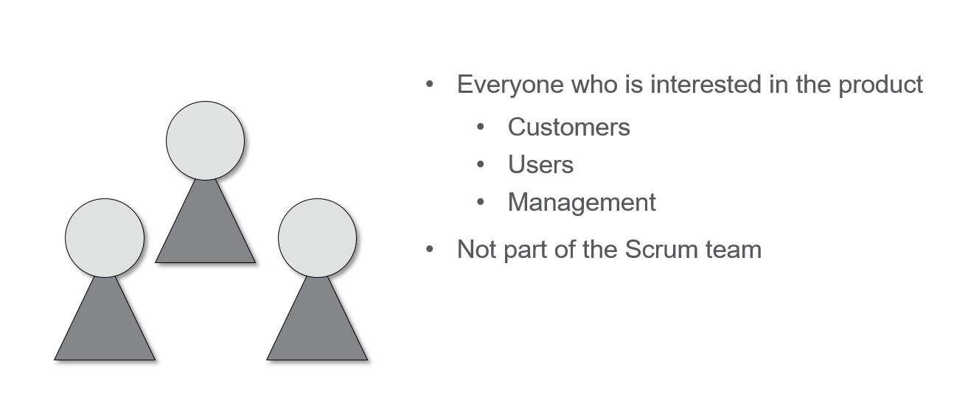
Stakeholders

Slide 25
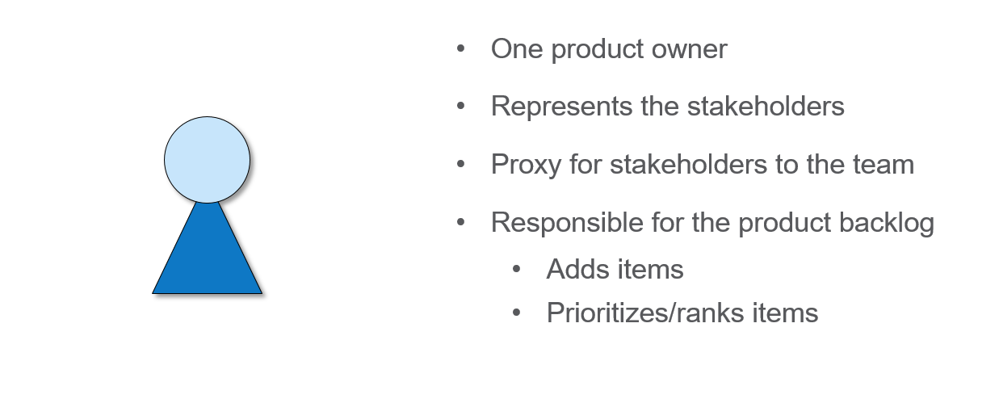
Product Owner (PO)

Slide 26
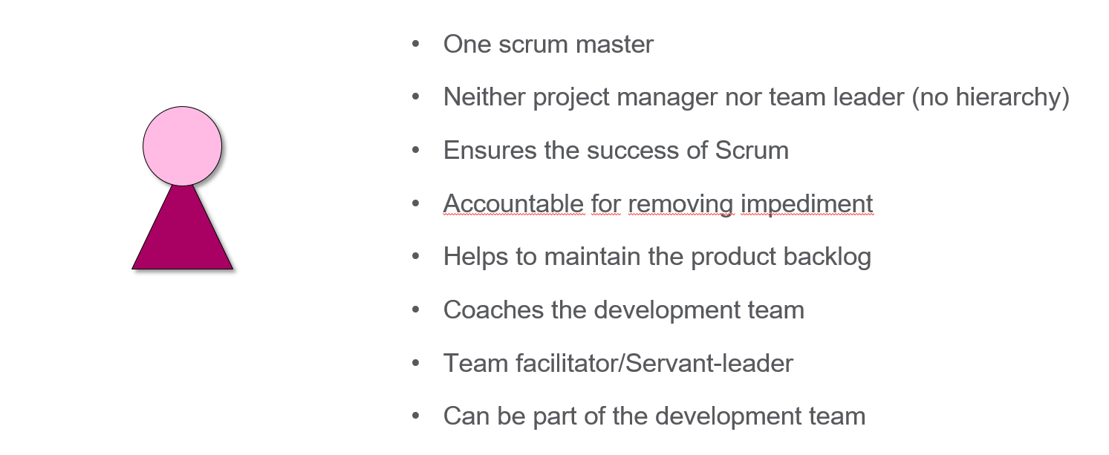
Scrum Master(SM)

Slide 27
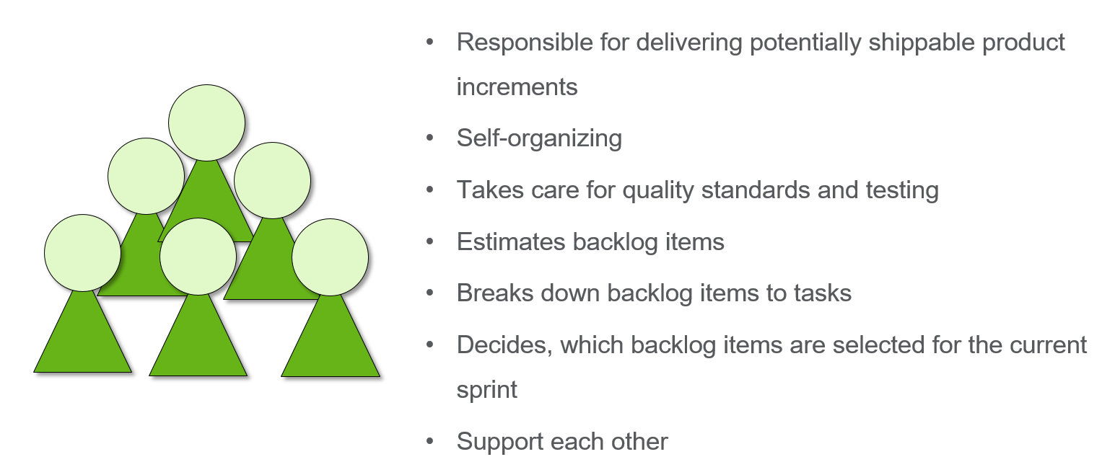
Development Team

Slide 28
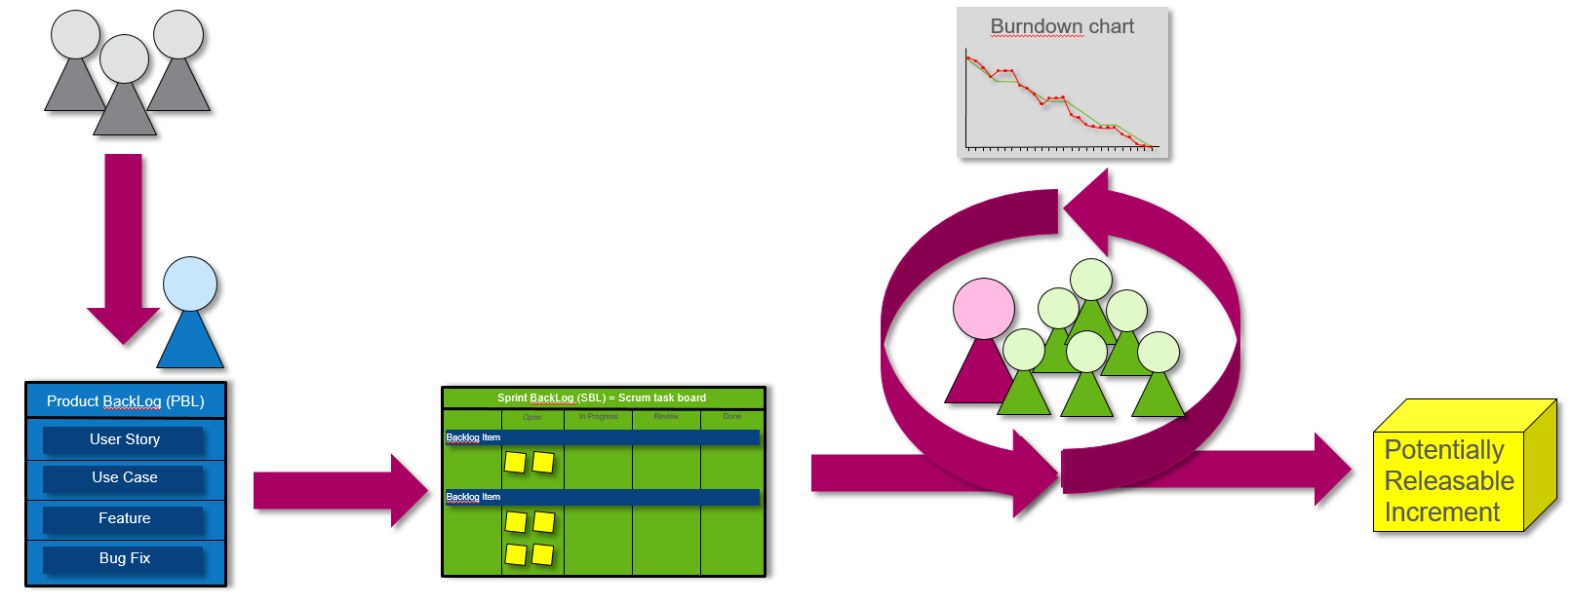
Putting it together…..

Slide 29
Scrum Framework
3 Artifacts:
Product Backlog
Sprint Backlog
Burn-down Chart
4 Roles:
Stakeholders
Product Owner
Scrum Master
Development Team
5 Meetings/Ceremonies:
Change control board
Sprint Planning
Daily Scrum
Sprint Review
Sprint Retrospective

Slide 30
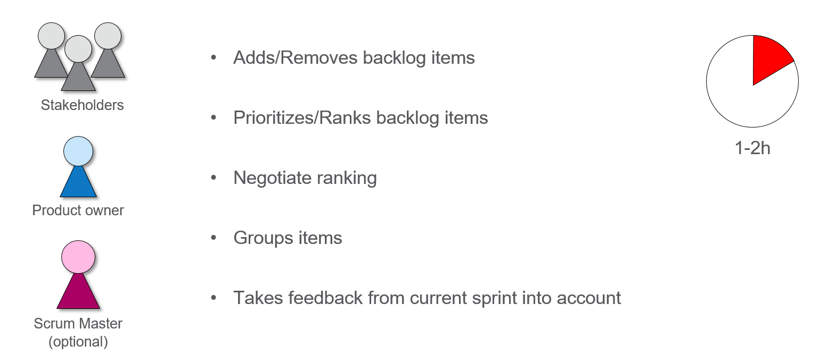
Change Control Board(CCB)

Slide 31
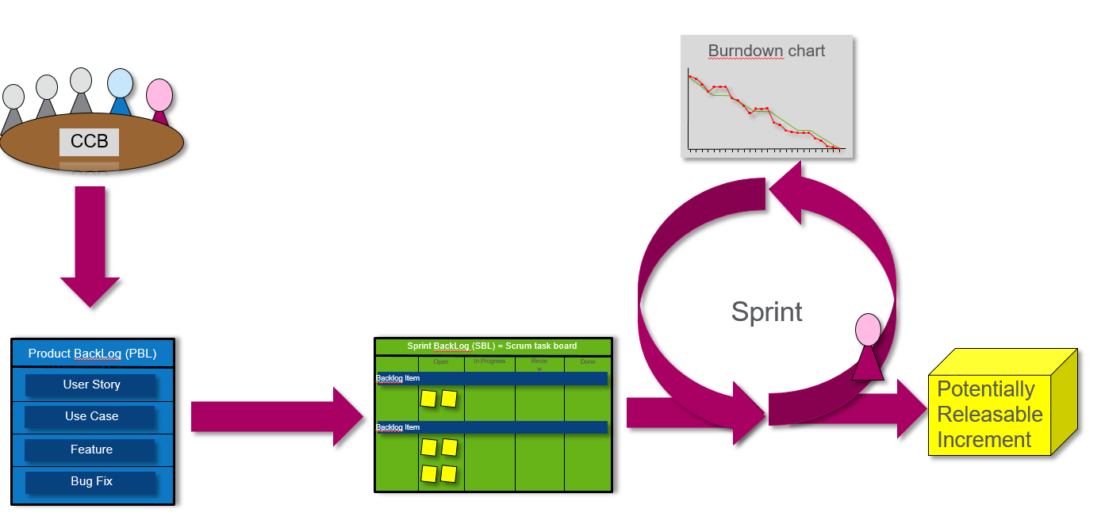
Putting it together…..

Slide 32
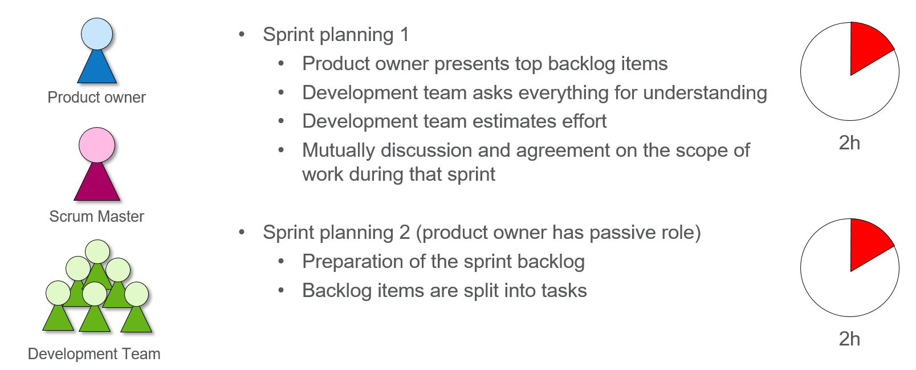
Sprint Planning

Slide 33
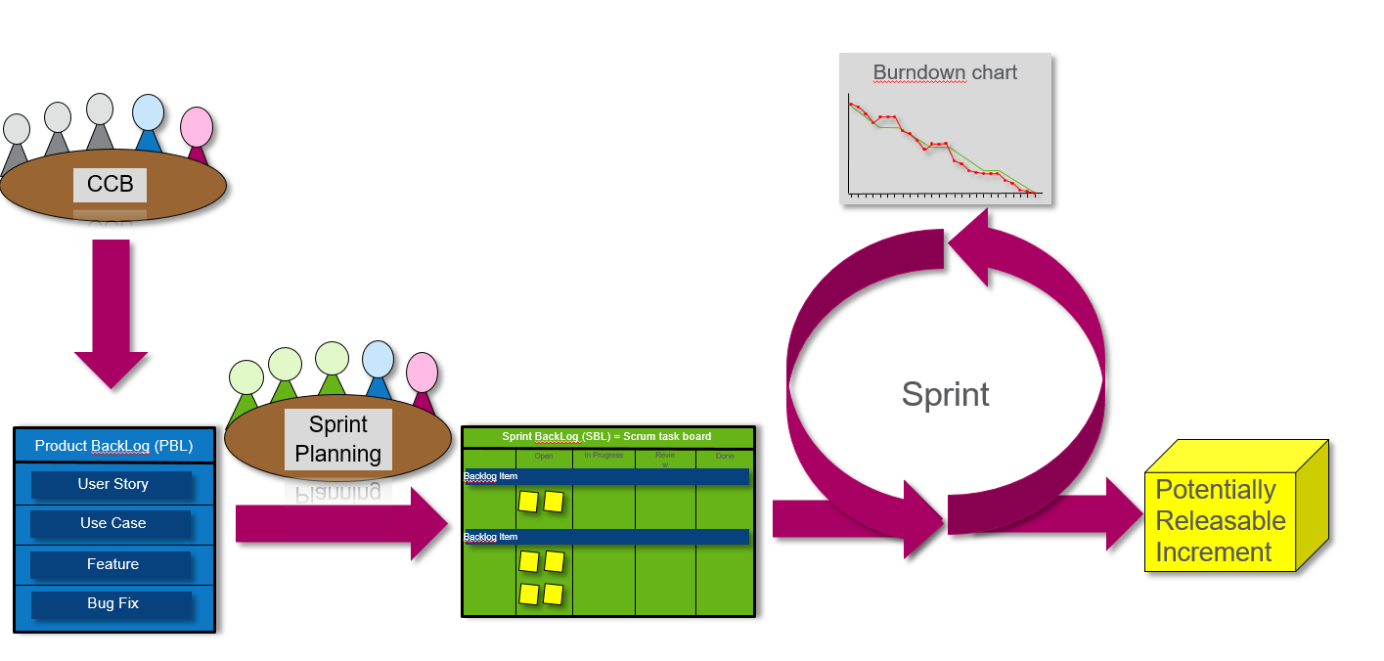
Putting it together…..

Slide 34
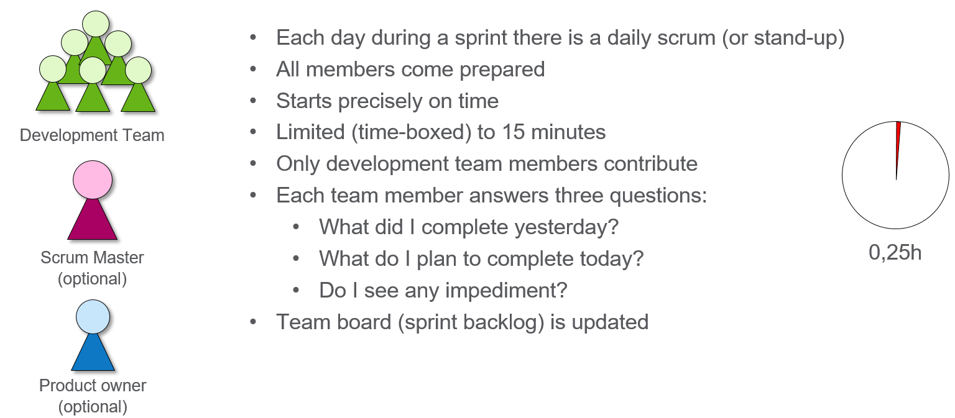
Daily Scrum

Slide 35
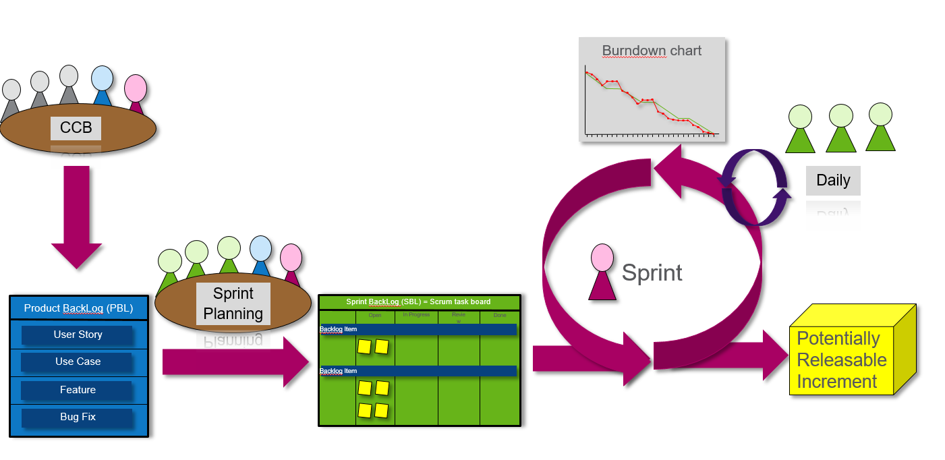
Putting it together…..

Slide 36
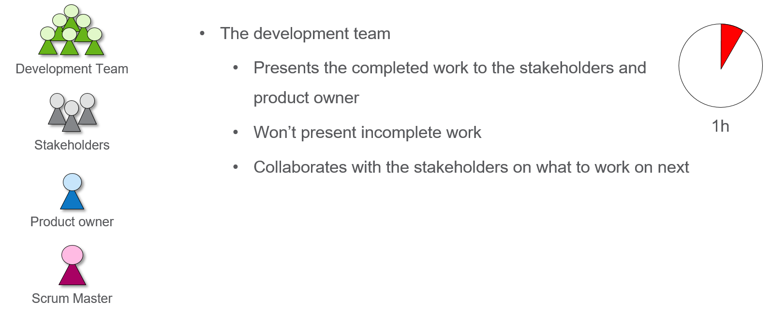
Sprint Review

Slide 37
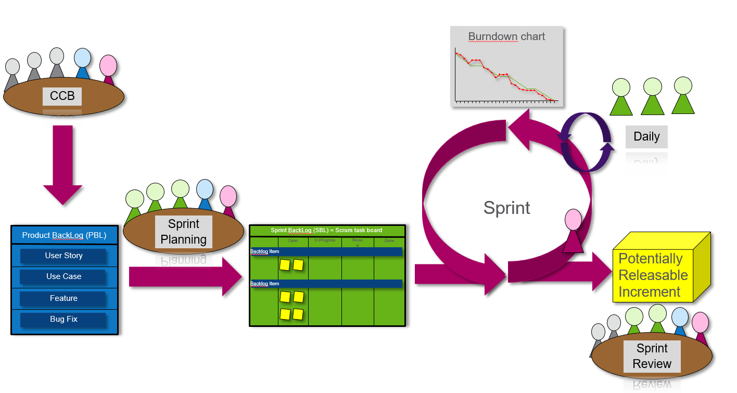
Putting it together…..

Slide 38
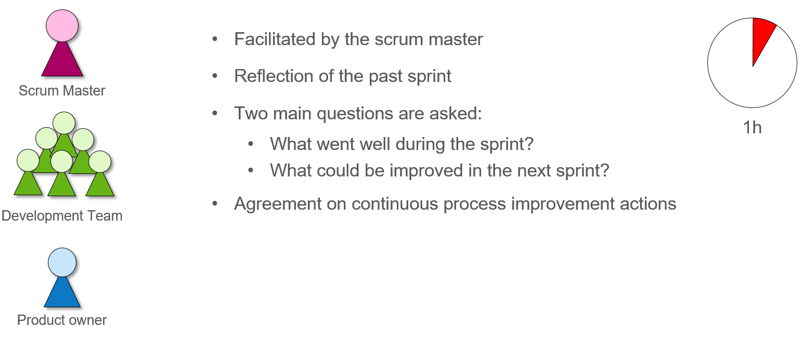
Sprint Retrospective

Slide 39
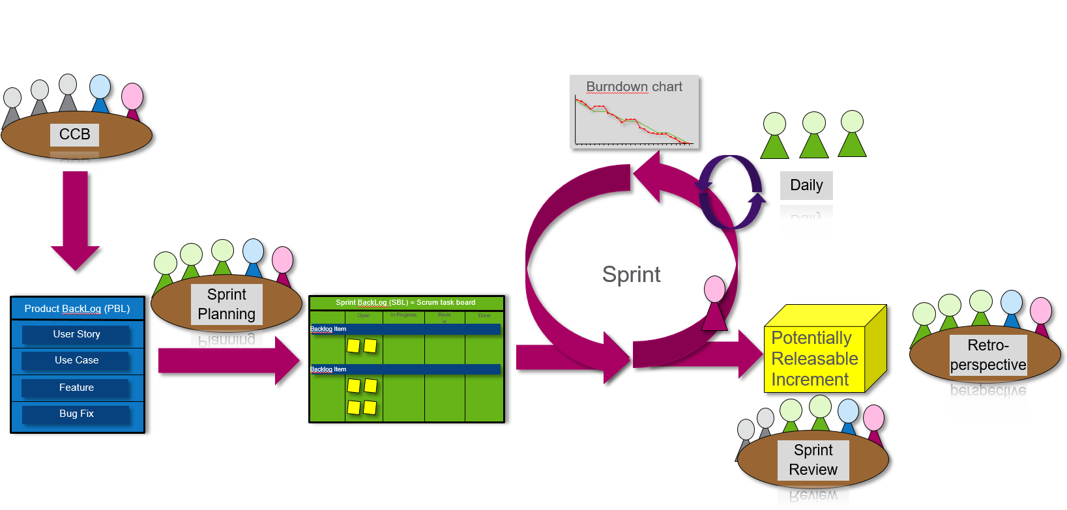
Finally… The whole Scrum Framework!

Slide 40
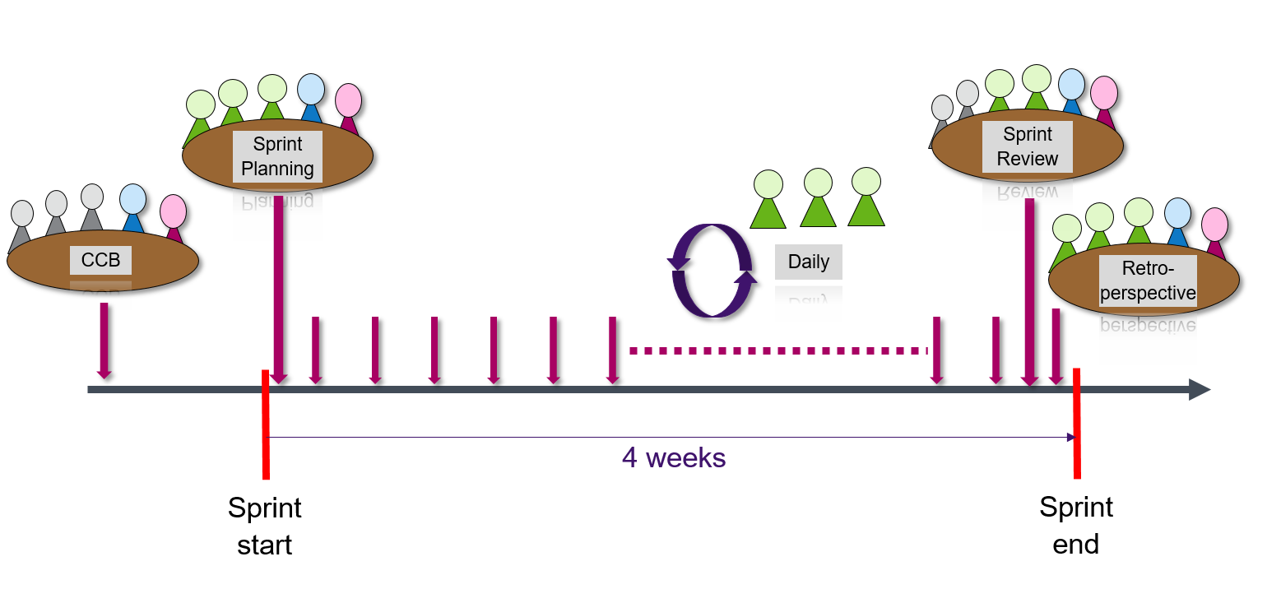
The timeline

Slide 41
Deepthi S
+91 9986256252
deepthi.s@testyantra.com

